Slide 1


Module 6: Variant calling, SNPs and short indels
Presented by:
Carla Daniela Robles Espinoza
Laboratorio Internacional de Investigación sobre el Genoma Humano
Universidad Nacional Autónoma de México
daniela_oaks
drobles@liigh.unam.mx
Based on slides by:
Petr Danecek
Next Generation Sequencing Bioinformatics Course
22-27 January 2023 - Santiago - Chile
FACULTAD DE
CIENCIAS BIOLOGICAS
PONTIFICIA UNIVERSIDAD CATÓLICA DE CHILE

Slide 2
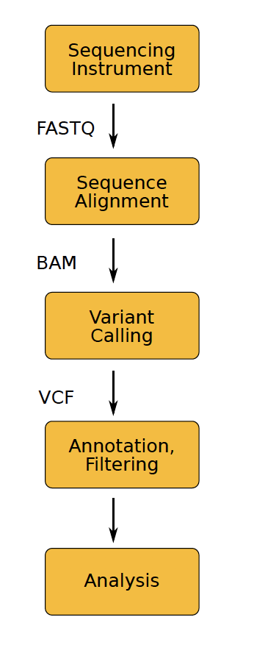
HTS workflow
Library preparation
DNA extraction
fragmentation
adapter ligation
amplification
Sequencing
base calling
de-multiplexing
Data processing
read mapping
variant calling
variant filtering
Analysis
Variant annotation
…
Notes:
We learned yesterday about data formats and do sequence alignment, and now today we will learn how to do variant calling, which gives us a VCF format
De-multiplexing per sample

Slide 3
Variant types
SNPs/SNVs . . . Single Nucleotide Polymorphism/Variation
ACGTTTAGCAT ACGTTCAGCAT
MNPs . . . Multi-Nucleotide Polymorphism
ACGTCCAGCAT ACGTTTAGCAT
Indels . . . short insertions and deletions
ACGTTTAGCA-TT ACGTT-AGCAGTT
SVs . . . Structural Variation
A A A A
A A
B C B
C
D C B C
C
B
C B
B

Slide 4
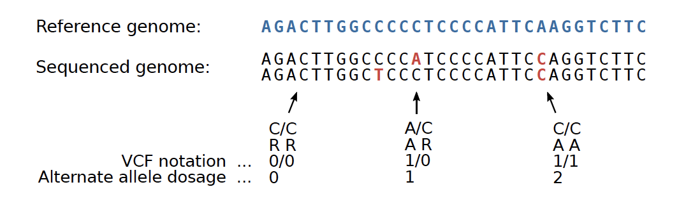
Some terminology
The goal is to determine the genotype at each position in the genome
Genotype
in the broad sense . . . genetic makeup of an organism
in the narrow sense . . . the combination of alleles at a position
Reference and alternate alleles - R and A Diploid organism
two chromosomal copies, three possible genotypes
RR .. homozygous reference genotype
RA .. heterozygous
AA .. homozygous alternate
Notes:
Before we start with variant calling I will remind you of some terminology that we also say yesterday

Slide 5
Germline vs somatic mutation
Germline mutation
heritable variation in the germ cells
Somatic mutation
variation in non-germline tissue, tumors. . .
Notes:
In terms of the algorithms used, they can be quite different

Slide 6
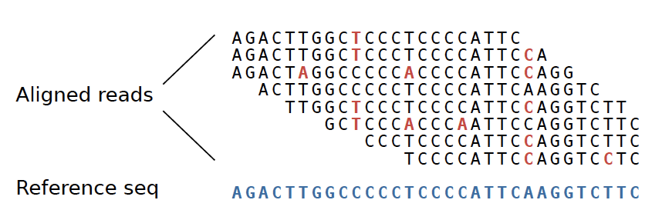
Germline vs somatic mutation
Germline mutation
heritable variation in the germ cells
Somatic mutation
variation in non-germline tissue, tumors. . .
Germline variant calling
expect the following fractions of alternate alleles in the pileup:
0.0 for RR genotype (plus sequencing errors)
1.0 for AA (plus sequencing errors)
0.5 for RA (random variation of binomial sampling)
Somatic
any fraction of alt AF possible - subclonal variation, admixture of normal cells in tumor sample
Notes:
Germline variant calling allows us to do some simplifications.
We assume that alleles are sampled from the two chromosomes. We should observe the frequency of the alternative allele in the sequenced reads to be either zero (reference genotype), 1 or 0.5, accounting for some random variation from binomial sampling – coin example
In somatic variant calling we can observe any fraction of allelic frequency possible, and it is a harder to detect some kinds of errors
IN red there are marked the differences against the reference

Slide 7
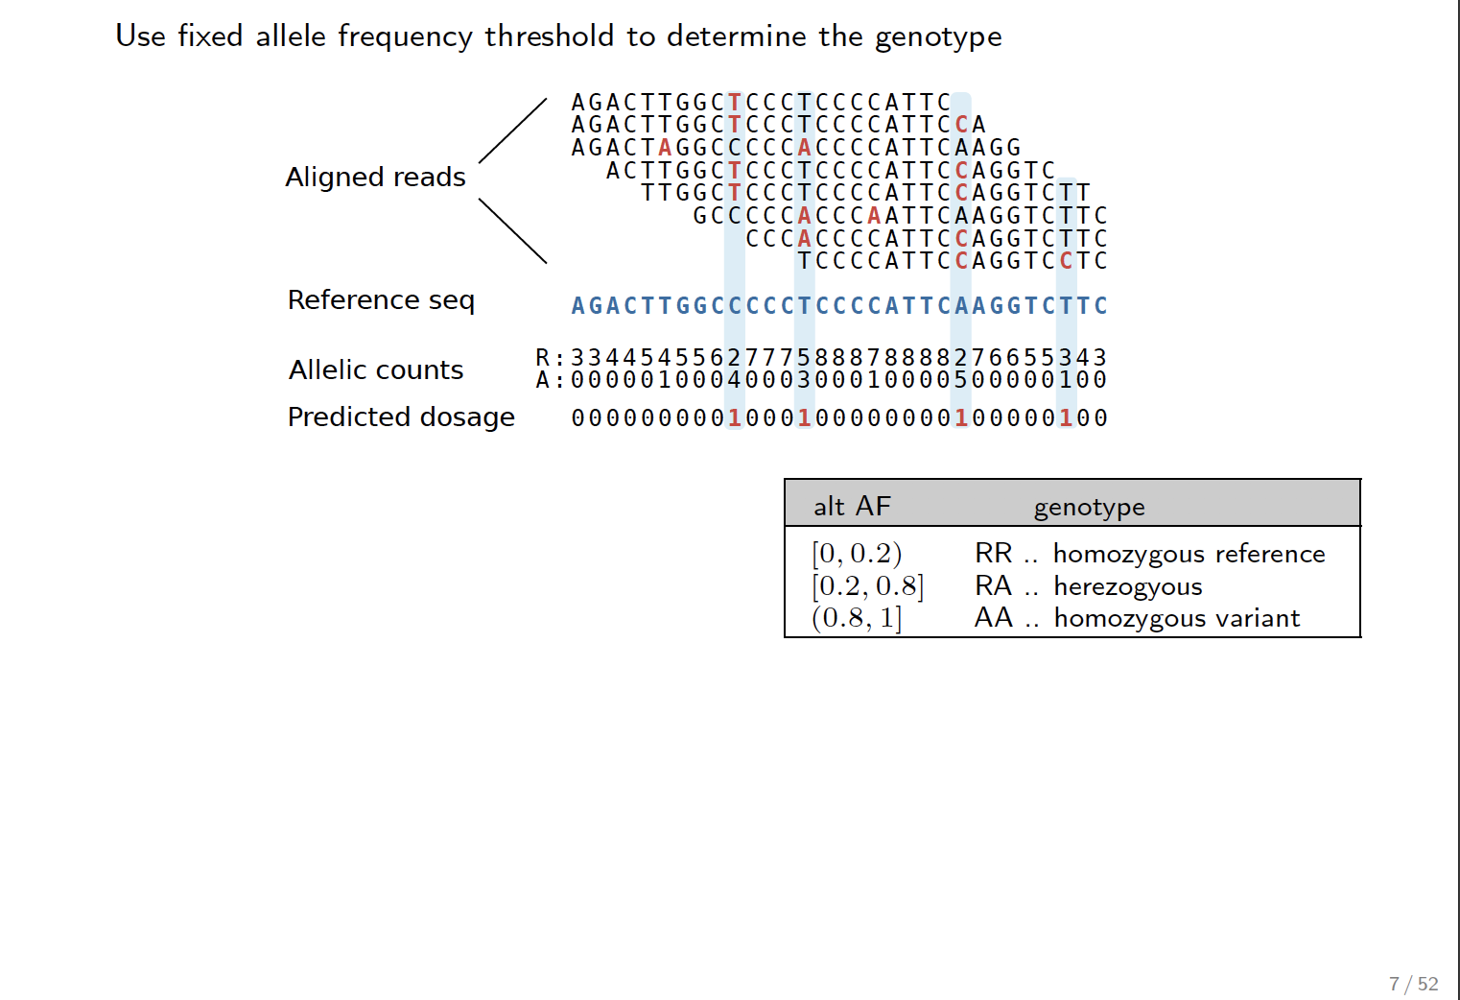
Naive variant calling
Use fixed allele frequency threshold to determine the genotype
A G A C T T G G C T C C C T C C C C A T T C
A G A C T T G G C T C C C T C C C C A T T C C A
A G A C T A G G C C C C C A C C C C A T T C A A G G A C T T G G C T C C C T C C C C A T T C C A G G T C T T G G C T C C C T C C C C A T T C C A G G T C T T G C C C C C A C C C A A T T C A A G G T C T T C
C C C A C C C C A T T C C A G G T C T T C T C C C C A T T C C A G G T C C T C
A G A C T T G G C C C C C T C C C C A T T C A A G G T C T T C
Aligned reads
Reference seq
Allelic counts Predicted dosage
R : 3 3 4 4 5 4 5 6 6 2 7 7 7 5 8 8 8 7 8 8 8 8 2 7 6 6 5 5 3 4 3
A : 0 0 0 0 0 1 0 0 0 4 0 0 0 3 0 0 0 1 0 0 0 0 5 0 0 0 0 0 1 0 0
0 0 0 0 0 0 0 0 0 1 0 0 0 1 0 0 0 0 0 0 0 0 1 0 0 0 0 0 1 0 0
alt AF |  | genotype
[0, 0.2) | RR | .. | homozygous | reference
[0.2, 0.8] | RA | .. | herezogyous
(0.8, 1] | AA | .. | homozygous | variant
heterozygous
Notes:
What would we think about doing variant calling, naively? Count R and A alleles
The problem with this approach is that it doesn’t take into account all the available information

Slide 8
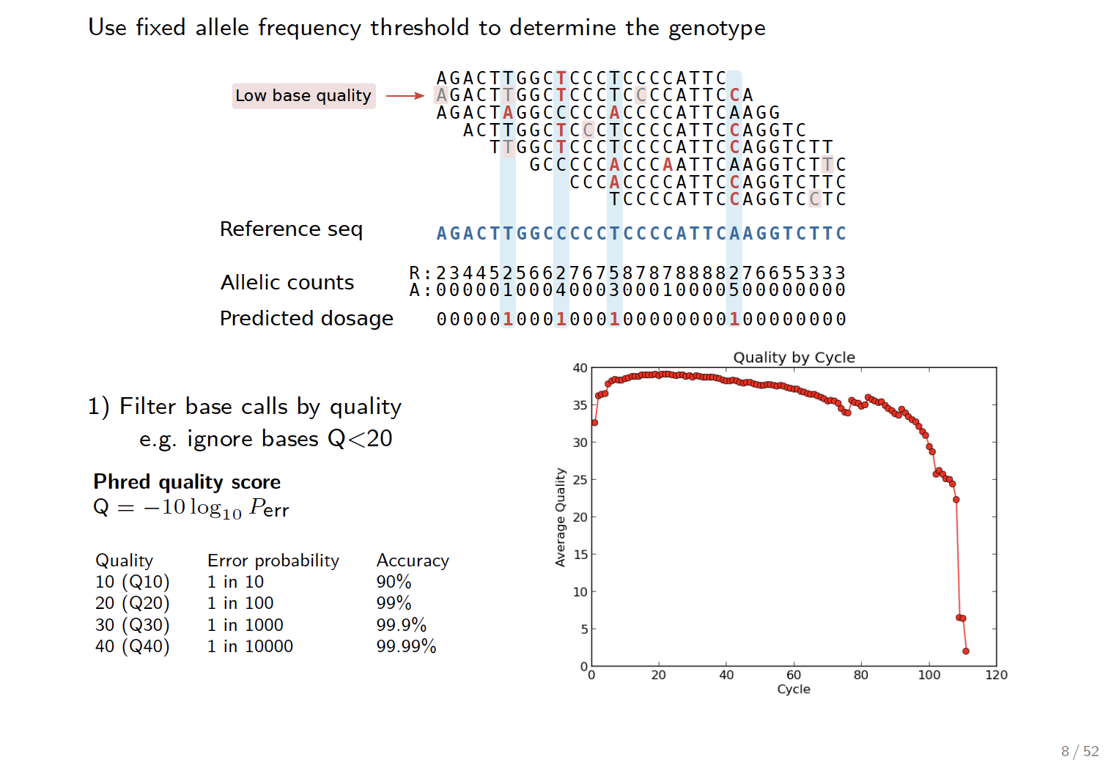
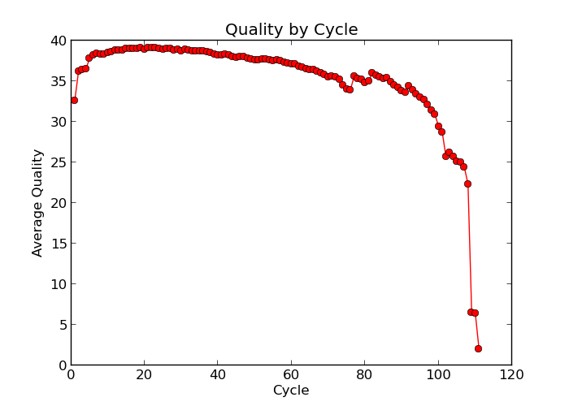
Naive variant calling
Use fixed allele frequency threshold to determine the genotype
A G A C T T G G C T C C C T C C C C A T T C
A G A C T T G G C T C C C T C C C C A T T C C A
A G A C T A G G C C C C C A C C C C A T T C A A G G A C T T G G C T C C C T C C C C A T T C C A G G T C T T G G C T C C C T C C C C A T T C C A G G T C T T G C C C C C A C C C A A T T C A A G G T C T T C
C C C A C C C C A T T C C A G G T C T T C T C C C C A T T C C A G G T C C T C
A G A C T T G G C C C C C T C C C C A T T C A A G G T C T T C
Low base quality
Reference seq
Allelic counts Predicted dosage
R : 2 3 4 4 5 2 5 6 6 2 7 6 7 5 8 7 8 7 8 8 8 8 2 7 6 6 5 5 3 3 3
A : 0 0 0 0 0 1 0 0 0 4 0 0 0 3 0 0 0 1 0 0 0 0 5 0 0 0 0 0 0 0 0
0 0 0 0 0 1 0 0 0 1 0 0 0 1 0 0 0 0 0 0 0 0 1 0 0 0 0 0 0 0 0
1) Filter base calls by quality
e.g. ignore bases Q<20
Phred quality score
Q = −10 log₁₀ Perr
Quality | Error probability | Accuracy
10 (Q10) | 1 in 10 | 90%
20 (Q20) | 1 in 100 | 99%
30 (Q30) | 1 in 1000 | 99.9%
40 (Q40) | 1 in 10000 | 99.99%
Notes:
Ignore low quality bases

Slide 9
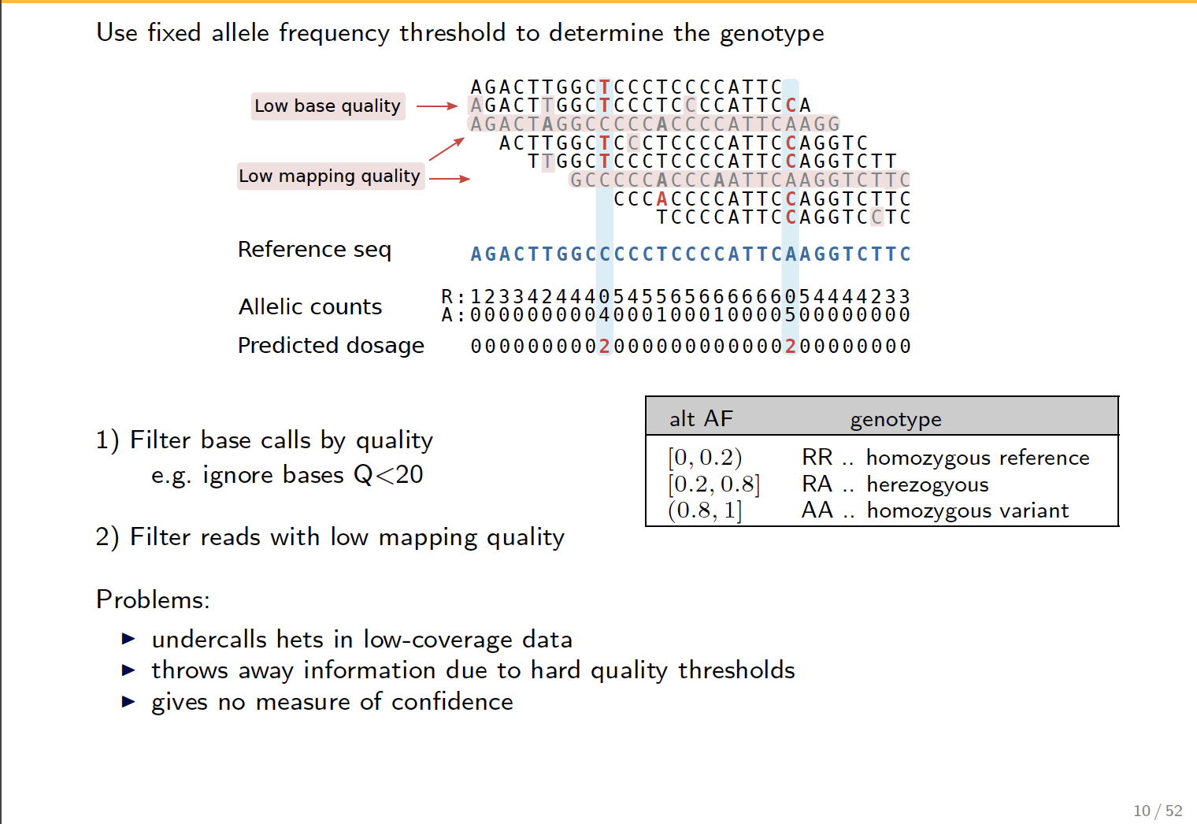
Naive variant calling
Use fixed allele frequency threshold to determine the genotype
A G A C T T G G C T C C C T C C C C A T T C
A G A C T T G G C T C C C T C C C C A T T C C A
A G A C T A G G C C C C C A C C C C A T T C A A G G A C T T G G C T C C C T C C C C A T T C C A G G T C T T G G C T C C C T C C C C A T T C C A G G T C T T G C C C C C A C C C A A T T C A A G G T C T T C
C C C A C C C C A T T C C A G G T C T T C T C C C C A T T C C A G G T C C T C
A G A C T T G G C C C C C T C C C C A T T C A A G G T C T T C
Low base quality
Low mapping quality
Reference seq
Allelic counts Predicted dosage
R : 1 2 3 3 4 2 4 4 4 0 5 4 5 5 6 5 6 6 6 6 6 6 0 5 4 4 4 4 2 3 3
A : 0 0 0 0 0 0 0 0 0 4 0 0 0 1 0 0 0 0 0 0 0 0 5 0 0 0 0 0 0 0 0
0 0 0 0 0 0 0 0 0 2 0 0 0 0 0 0 0 0 0 0 0 0 2 0 0 0 0 0 0 0 0
1) Filter base calls by quality
e.g. ignore bases Q<20
alt AF |  | genotype
[0, 0.2) | RR | .. | homozygous | reference
[0.2, 0.8] | RA | .. | herezogyous
(0.8, 1] | AA | .. | homozygous | variant
heterozygous
Filter reads with low mapping quality Problems:
undercalls hets in low-coverage data
throws away information due to hard quality thresholds
Gives no measure of confidence
Notes:
But then we can also take into account mapping quality

Slide 10
Naive variant calling
Use fixed allele frequency threshold to determine the genotype
A G A C T T G G C T C C C T C C C C A T T C
A G A C T T G G C T C C C T C C C C A T T C C A
A G A C T A G G C C C C C A C C C C A T T C A A G G A C T T G G C T C C C T C C C C A T T C C A G G T C T T G G C T C C C T C C C C A T T C C A G G T C T T G C C C C C A C C C A A T T C A A G G T C T T C
C C C A C C C C A T T C C A G G T C T T C T C C C C A T T C C A G G T C C T C
A G A C T T G G C C C C C T C C C C A T T C A A G G T C T T C
Low base quality
Low mapping quality
Reference seq
Allelic counts Predicted dosage
R : 1 2 3 3 4 2 4 4 4 0 5 4 5 5 6 5 6 6 6 6 6 6 0 5 4 4 4 4 2 3 3
A : 0 0 0 0 0 0 0 0 0 4 0 0 0 1 0 0 0 0 0 0 0 0 5 0 0 0 0 0 0 0 0
0 0 0 0 0 0 0 0 0 2 0 0 0 0 0 0 0 0 0 0 0 0 2 0 0 0 0 0 0 0 0
1) Filter base calls by quality
e.g. ignore bases Q<20
alt AF |  | genotype
[0, 0.2) | RR | .. | homozygous | reference
[0.2, 0.8] | RA | .. | herezogyous
(0.8, 1] | AA | .. | homozygous | variant
Filter reads with low mapping quality Problems:
undercalls hets in low-coverage data
throws away information due to hard quality thresholds
Gives no measure of confidence
Notes:
You can see the problems there – it undercalls heterozygous genotypes in low-coverage data, we may miss them completely or we may mistake them for homozygous alternative calls
We also throw away information due to hard quality thresholds – for example in some positions here we have thrown away some bases due to these thresholds, but there is cumulative information here, even if they are low quality, if you have a stack of Ts, that is telling you something
Also, we have no quality information coming from this approach, for example, to tell us we have called a certain variant with more confidence than we have called other variants. So we need to do better

Slide 11
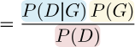
Real life calling models
More sophisticated models apply a statistical framework
Likelihood
Prior
Posterior
Normalization
to determine:
1. the most likely genotype g ∈ {RR, RA, AA} given the observed data D
g = argmax P (G|D)
G
2. and the genotype quality
30
25
20
15
10
5
Q= -10log₁₀[1-P(G|D)]
Q = −10 log₁₀[1 − P (G|D)]
Q
0
0.0 0.2 0.4 0.6 0.8 1.0
P(G|D)
Notes:
There is statsitical theory that we can use for this – you may be familiar with Bayes theorem, but don’t worry if not, we will cover here what you will need to know, and so you have some appreciation of what the prpgrams you will be using are doing under the hood – GATK and samtools mpileup use this
The task is now to determine the most likely genotype given a likelihood, which will be represented by our data, a prior, representing our beliefs about the presence of variants in the genome we are analysing, and a normalisation term
Reported as a phred score
Because this formula gives you a probability, you can also derive a quality score, or a mesaure of confidence. The higher the probability of a genotype given our data, the higher the quality

Slide 12
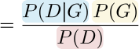
Important terms you may encounter
Genotype likelihoods
which of the three genotypes RR, RA, AA is the data most consistent with?
calculated from the alignments, the basis for calling
takes into account:
base calling errors
mapping errors
statistical fluctuations of random sampling
local indel realignment (base alignment quality, BAQ)
Prior probability
how likely it is to encounter a variant base in the genome?
some assumptions are made
allele frequencies are in Hardy-Weinberg equilibrium
P(RA) = 2f (1 − f ), P(RR) = (1 − f )², P(AA) = f ²
can take into account genetic diversity in a population
Notes:
Genotype likelihoods represent a measure of how consistent our data, our reads with each possible genotype
BAQ - Problems arising from ambiguous mapping
Normalisation term

Slide 13
Variant calling example
Inputs
alignment file
reference sequence
Outputs
VCF or BCF file
Example
bcftools mpileup -f ref.fa aln.bam | bcftools call -mv
Tips
bcftools mpileup
increase/decrease the required number (-m) and the fraction (-F) of supporting reads for indel calling
the -Q option controls the minimum required base quality (30)
BAQ realignment is applied by default and can be disabled with -B
streaming the uncompressed binary BCF (-Ou) is much faster than the default text VCF
bcftools call
decrease/increase the prior probability (-P) to decrease/increase sensitivity
General advice
take time to understand the options
play with the parameters, see how the calls change
Notes:
What does variant calling actually look like
First part of the program calculates the genotype likelihoods, and the second part decides on the genotype, so does the actual calling
There are many options that you can tweak.

Slide 14
Factors to consider in calling
Many calls are not real, a filtering step is necessary
False calls can have many causes
contamination
PCR errors
sequencing errors
homopolymer runs
mapping errors
repetitive sequence
structural variation
alignment errors
false SNPs in proximity of indels
ambiguous indel alignment
Notes:
How do you know you can trust the data?
Mapping is putting the read in a place
Alignment is the final details of that process

Slide 15
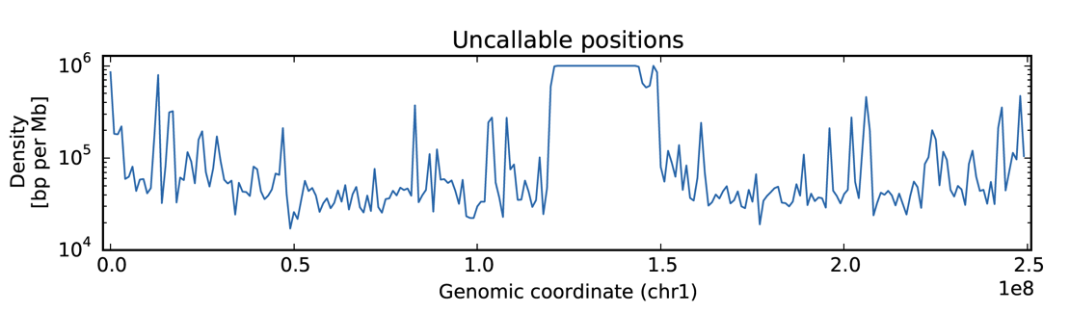
Callable genome
Large parts of the genome are still inaccessible
the Genome in a Bottle high-confidence regions:
cover 89% of the reference genome
are short intervals scattered across the genome
Notes:
First thing we should mention is this concept of callable genome, because despite what you may think or hear, large parts of the genome are still inaccessible. Project genome in a bottle – defines high confidence regions, and it is a good project for if you decide to test some assumptions about variant calling. Highly validated sites that you can test your assumptions again
Defines these high confidence regions that we are sure we can call confidently, and the rest we are not so sure. These high confident regions cover 89%.
Uncallable positions – logarithmic scale, 1MB bins
Look at centromere and telomeres, we can’t call that confidently. Across the whole genome there are some regions where we are not so confident that we can call, for example, due to repetitive regions
It’s not that bad – just be careful about how you interpret the results

Slide 16

Callable genome
Large parts of the genome are still inaccessible
the Genome in a Bottle high-confidence regions:
cover 89% of the reference genome
are short intervals scattered across the genome
If possible, include only ”nice” regions: for many analyses (e.g. population genetic studies) difficult regions can be ignored

Slide 17
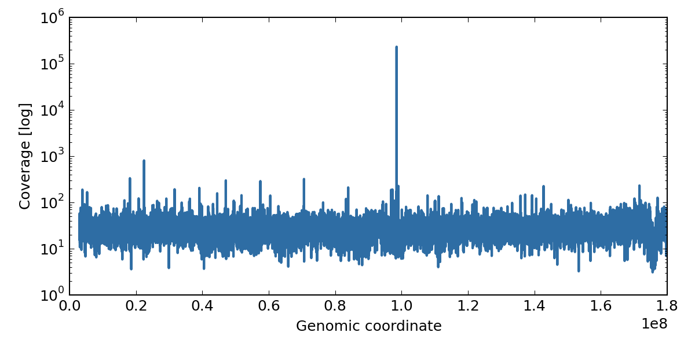
Maximum depth
Q: Why is the sequencing depth thousandfold the average in some regions?
Notes:
Maximum depth – mouse data
Average depth is 30x, but there is here a region with 1000 fold the coverage. Why do you think this is?

Slide 18
Maximum depth
Q: Why is the sequencing depth thousandfold the average in some regions?
A. The reference genome is not complete. This sample was sequenced to 30x coverage, we can infer it has ~30 copies of this region.
Notes:
Repeats. Sample had many more repeats of a region that in the reference. This for example tells you that if you see a variant supported with way more reads than the rest of your variants or your average depth, then we should exclude it as an artifact.

Slide 19
Maximum depth
Q: Why is the sequencing depth thousandfold the average in some regions?
A. The reference genome is not complete. This sample was sequenced to 30x coverage, we can infer it has ~30 copies of this region.
Filter calls with a too high (for example, 2x the average in WGS)

Slide 20
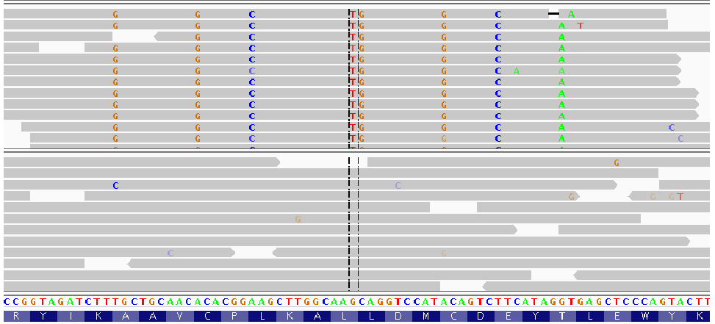
Mapping errors
Q: RNA-seq (top) and DNA data (bottom) from the same sample has been mapped onto the reference genome. Can you explain the novel SNVs?
A. The reads were mapped to a pseudogene and originate in a paralog with 92% identity
Beware of mapping errors, especially when aligning RNA-seq data on the genome
Notes:
Top shows RNAseq data, bottom shows DNA data from the sample. Both were aligned to the reference, but you see this striking pattern where the transcriptome reads seems heavily edited, and well, we know about RNA editing, so a group wrongly concluded that this was a new pattern of RNA editing, which they published in Science. But we can try and be mor ecareful and look at these data. What do you think is happening here?

Slide 21
Mapping errors
Q: RNA-seq (top) and DNA data (bottom) from the same sample has been mapped onto the reference genome. Can you explain the novel SNVs?
A. The reads were mapped to a pseudogene and originate in a paralog with 92% identity
Beware of mapping errors, especially when aligning RNA-seq data on the genome
Notes:
When you sequence reads that are spliced, you may be able to map them somewhere else

Slide 22
Mapping errors
Q: RNA-seq (top) and DNA data (bottom) from the same sample has been mapped onto the reference genome. Can you explain the novel SNVs?
A. The reads were mapped to a pseudogene and originate in a paralog with 92% identity
Beware of mapping errors, especially when aligning RNA-seq data on the genome

Slide 23
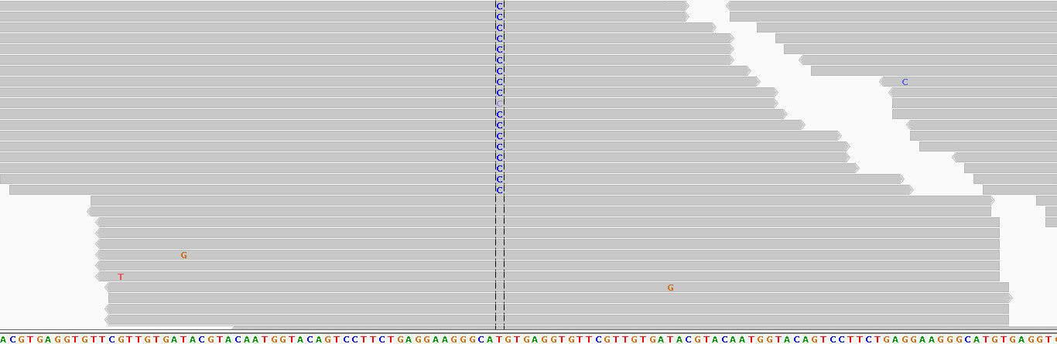
Strand bias
Q: Is this a valid call?
Notes:
What do you think of this one? Sorted by variant site

Slide 24
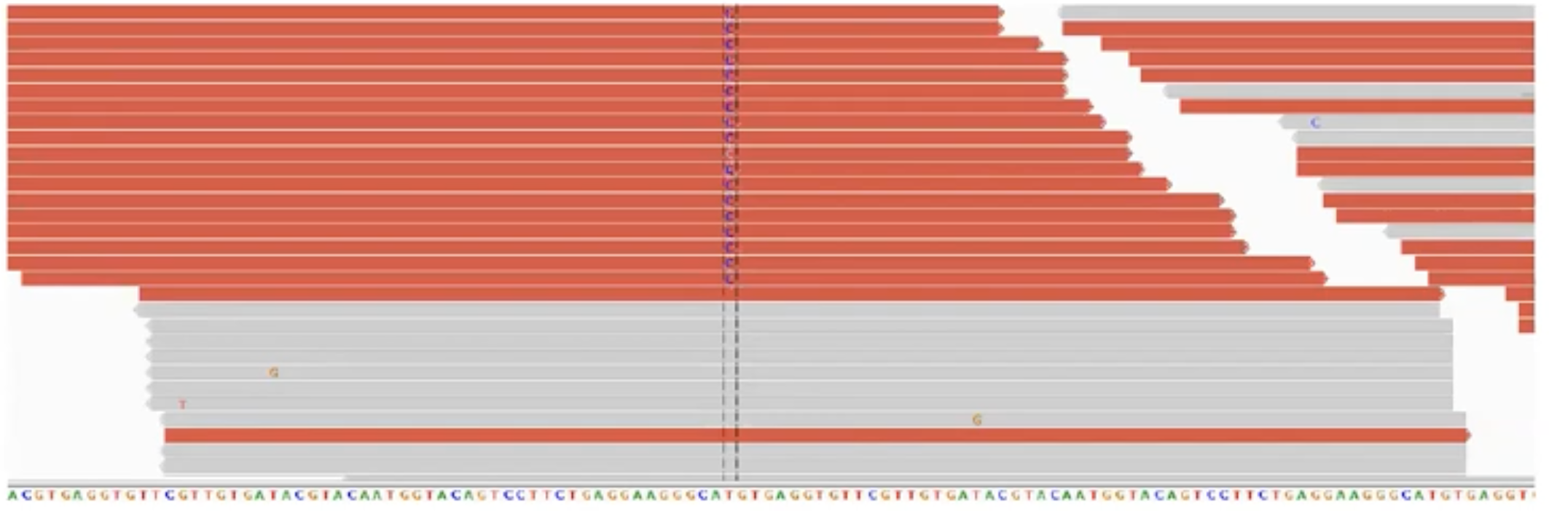
Strand bias
Q: Is this a valid call?
A. No, it is a mapping artifact, the call is supported by forward reads only.
Notes:
But if you look at the direction of these calls, and use the IGV feature to color by the direction of the reads strand. So this may be a mapping artifact or sequencing artifact

Slide 25
Strand bias
Q: Is this a valid call?
A. No, it is a mapping artifact, the call is supported by forward reads only.
Filter extremely biased calls using annotations generated by your caller
(e.g. Fisher or rank-sum test)
Notes:
Programs generate these annotations and you can use them in your post-variant ciltering to ignore these calls

Slide 26
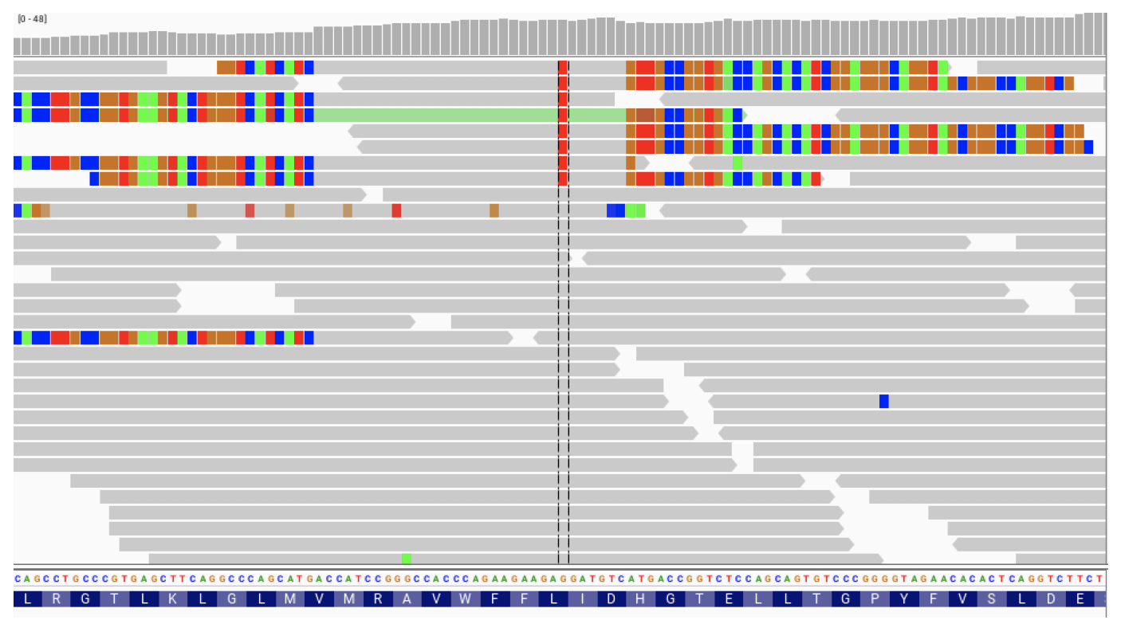
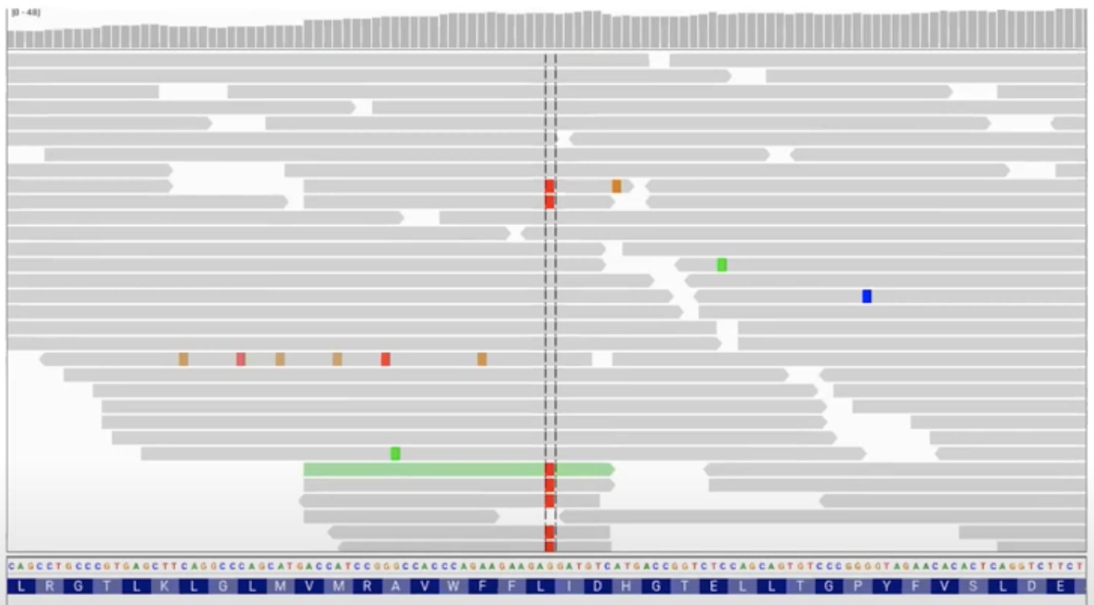
Change the display in IGV to reveal artifacts
Notes:
Sort by base then display soft clipped reads

Slide 27
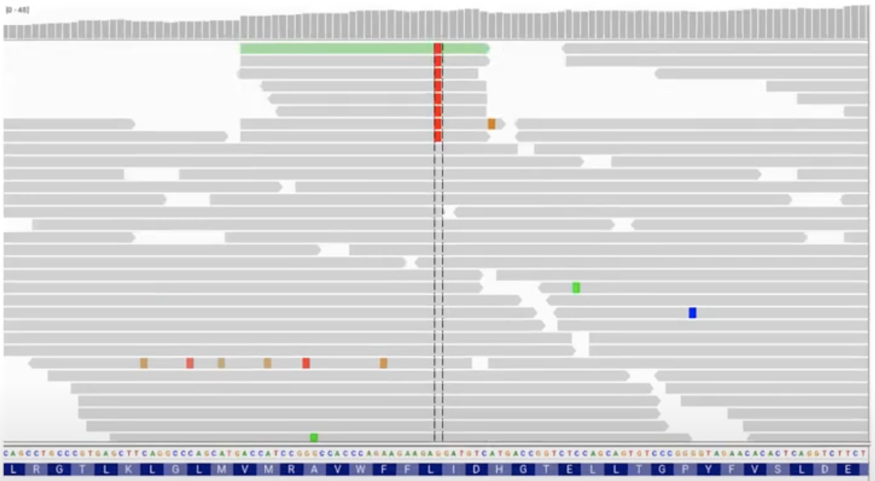
Change the display in IGV to reveal artifacts
First sort by variant base…
Notes:
Very short reads, so this is strange

Slide 28
Change the display in IGV to reveal artifacts
Display soft-clipped bases…
Too many soft-clipped reads in a region suggest mapping errors, beware!
Notes:
Sort by base then display soft clipped reads
Reads are normal length, but the program had to soft clip heavily, and all the variant bases are in the soft clipped reads, so we do not trust this variant

Slide 29
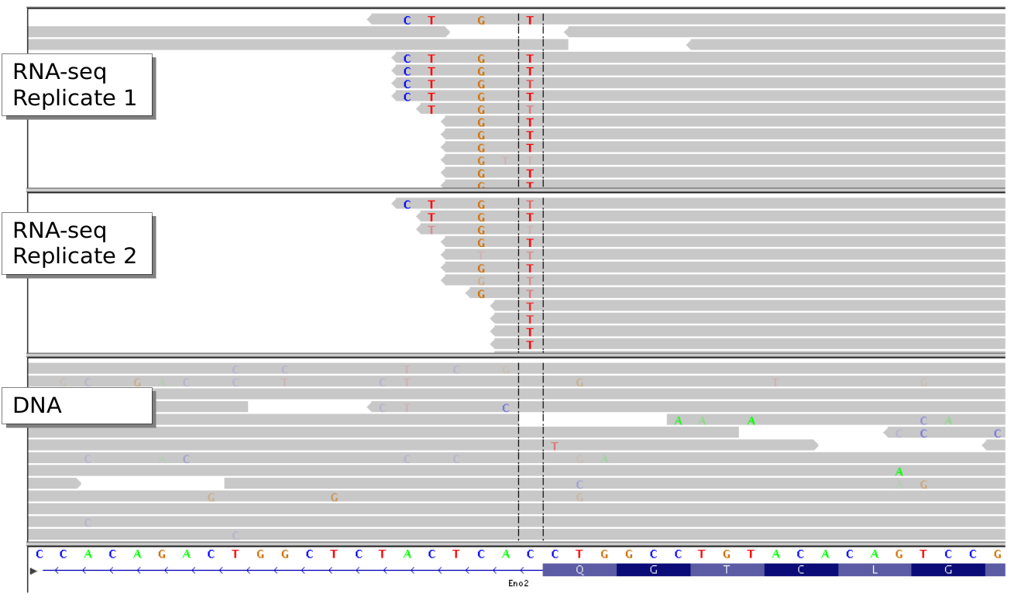
Variant distance bias
Q: Can you explain what happened here?
Notes:
Similar to before, two RNA replicates and the DNA genome, for some reason there is a lot of variation here at the end of this exon

Slide 30
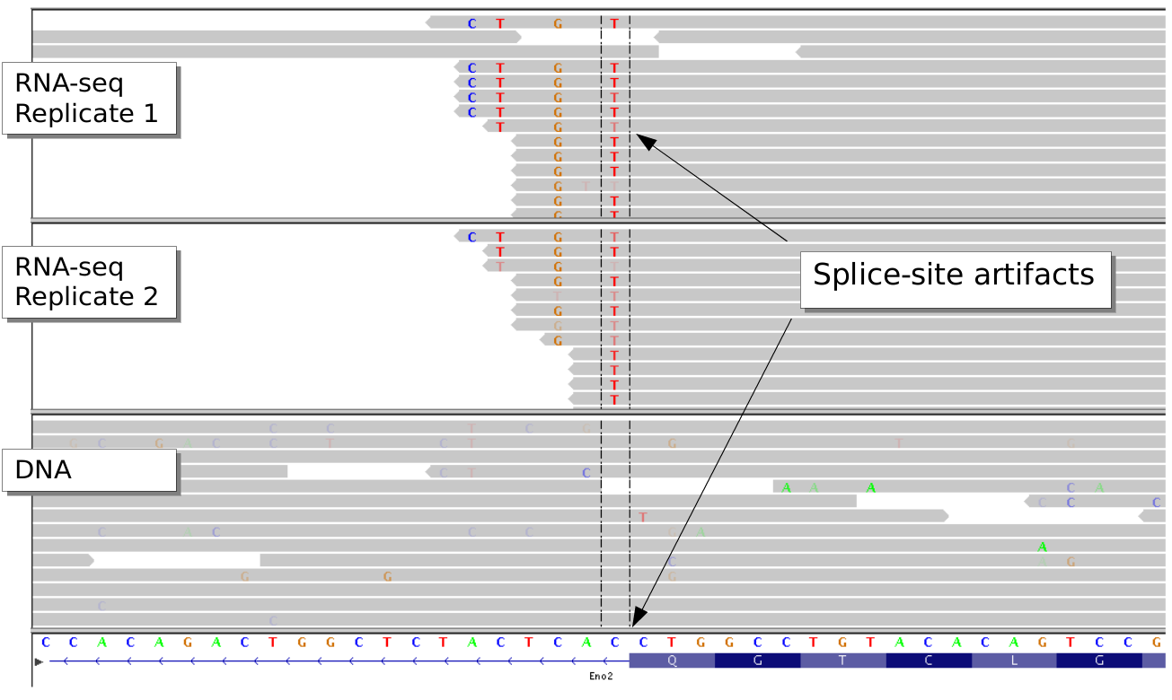
Q: Can you explain what happened here?
A: Processed transcript with introns spliced out.
Notes:
Normal aligners will not attempt to introduce these huge introns into the alignment, as it would be a large penalti, and so it prefers all these SNPs at the end

Slide 31
Q: Can you explain what happened here?
A: Processed transcript with introns spliced out.
Better to use a splice-aware mapper when working with RNA-seq data, or filter most extreme cases using annotations such as VDB

Slide 32
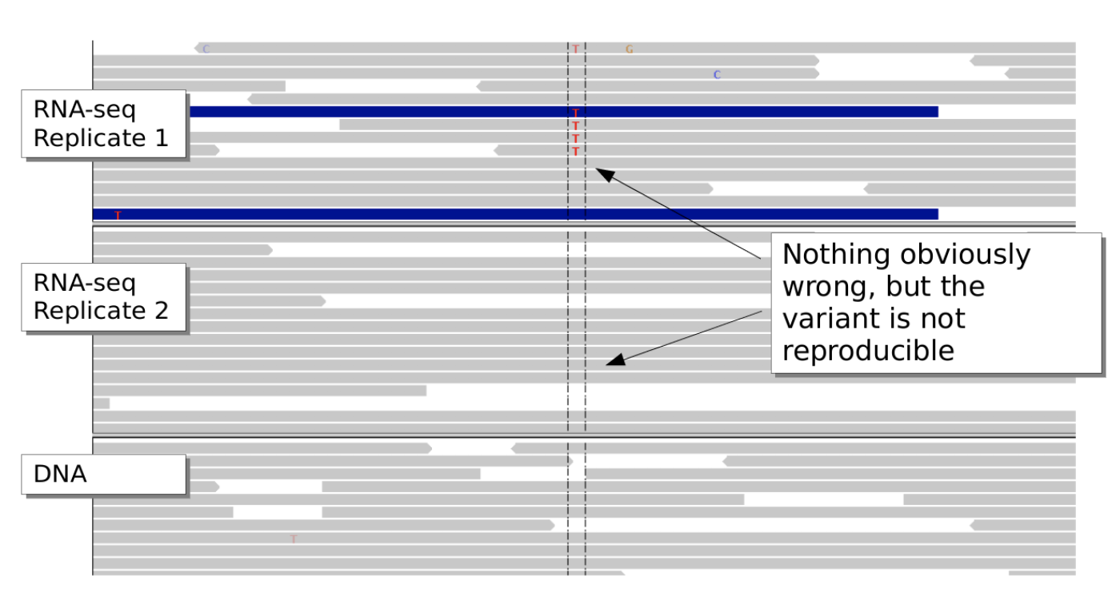
Reproducibility
Notes:
If you do these things, and you observe that everything is clean, your IGV plot looks great, but you have additional evidence and this is conflicting, then maybe be extra careful there – It is hard to explain, but would be a red flag that something may not be completely right

Slide 33
Reproducibility
Mind the biological variability. If possible, validate and replicate

Slide 34
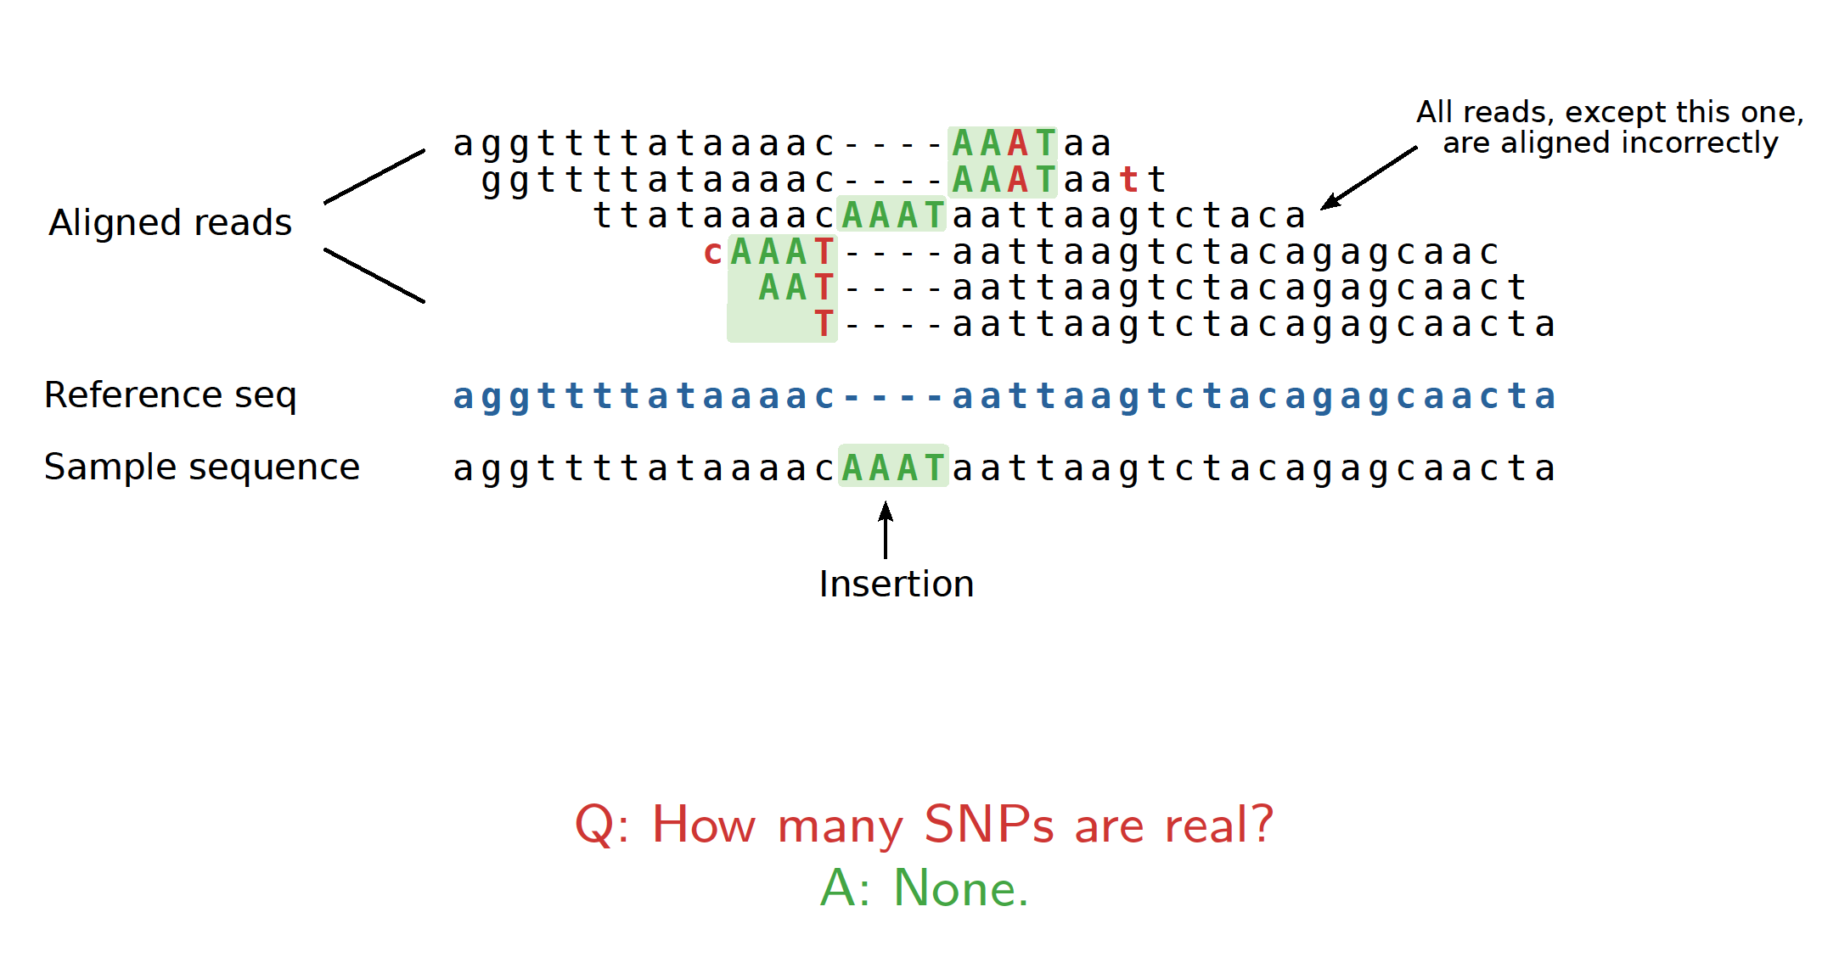
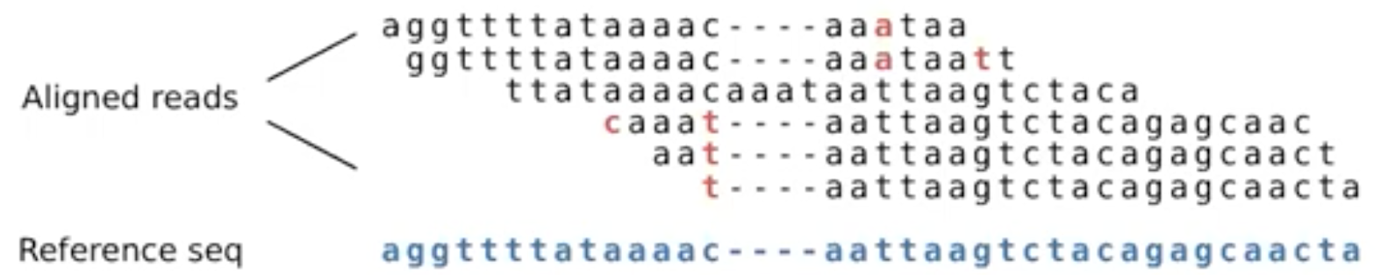
False SNPs caused by incorrect alignment
Pairwise alignemnt artefacts can lead to false SNPs
multiple sequence alignment is better, but very expensive
instead: base alignment quality (BAQ) to lower quality of misaligned bases
Notes:
About indels – differences between mapping and alignment
BAQ – Some SNPs are not real, especially if they are in the vicinity of indels, can be an artifact of alignment
In this case there is the reference sequence, and it seems that one read has one insertion and there are some other snps around. The question is, do you think these SNPs are real?
Think about it

Slide 35
False SNPs caused by incorrect alignment
Pairwise alignemnt artefacts can lead to false SNPs
multiple sequence alignment is better, but very expensive
instead: base alignment quality (BAQ) to lower quality of misaligned bases
Notes:
All reads except the one in the middle, are aligned incorrectly. There is an insertion in the sample. The green block is the same sequence in all reads, but in some cases it was more optimal to place it here and put one SNP than opening an insertion
Problem of mapping and alignment – needs to be super fast, they come in a random order, see one read, align it in the best way possible, but only in variant calling can we see all the reads in their context. So here we can realise that this isn’t real. There are filters we can apply to take care of these, and we can also implement BAQ, which will lower the quality of these misaligned bases

Slide 36
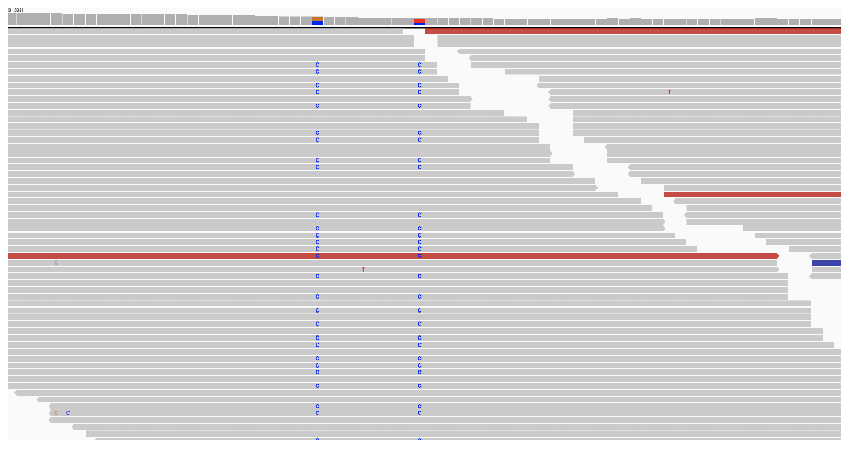
What do good SNPs look like?
Notes:
But now we should also see how good alignments and variants look like

Slide 37
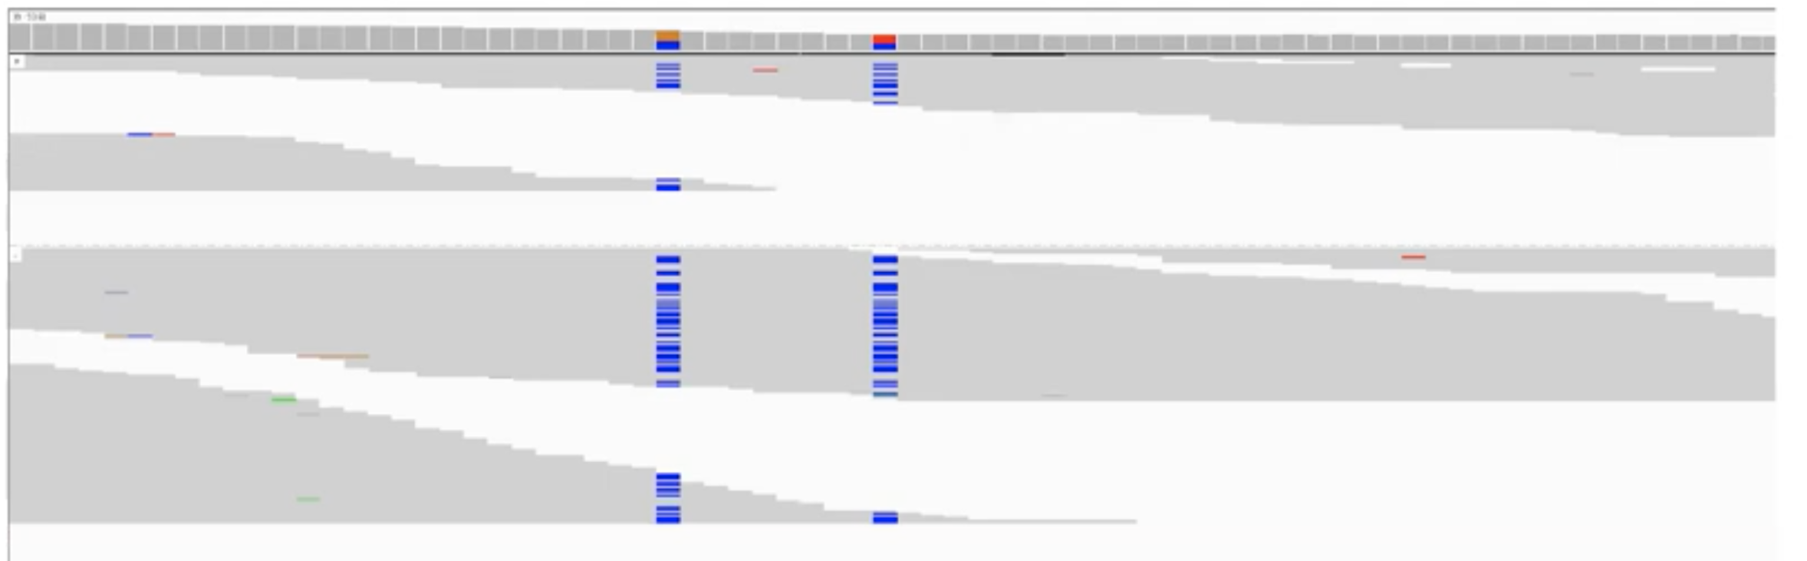
What do good SNPs look like?
Notes:
Change the view to see possible bieases, here you can swuish the reads to see the whole picture and you can sort by strandand in this way you can confirm two unbiased calls

Slide 38
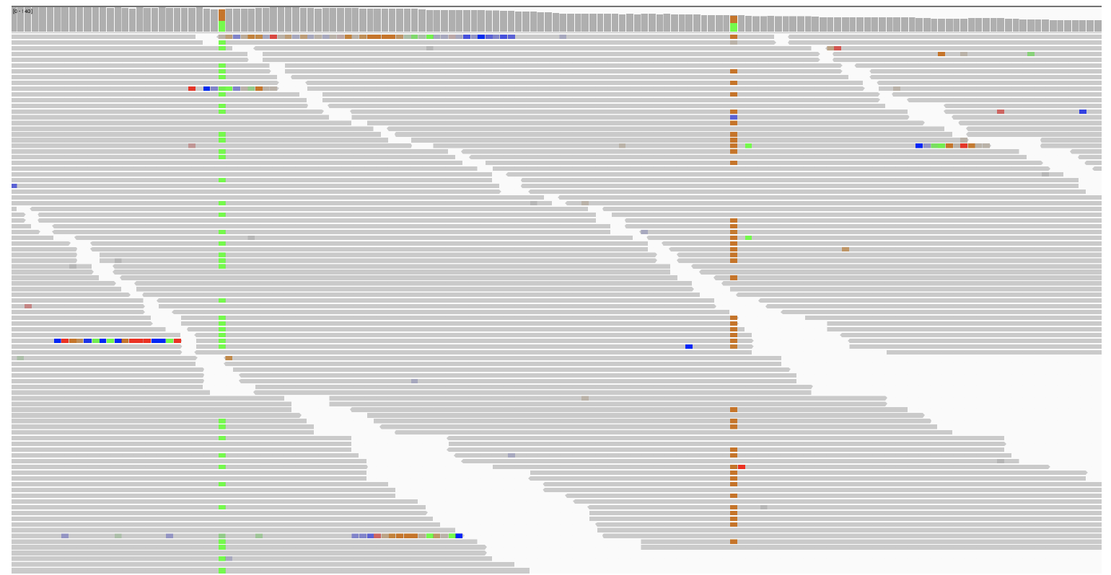
What do good SNPs look like?
Notes:
Again you an sort and colour

Slide 39
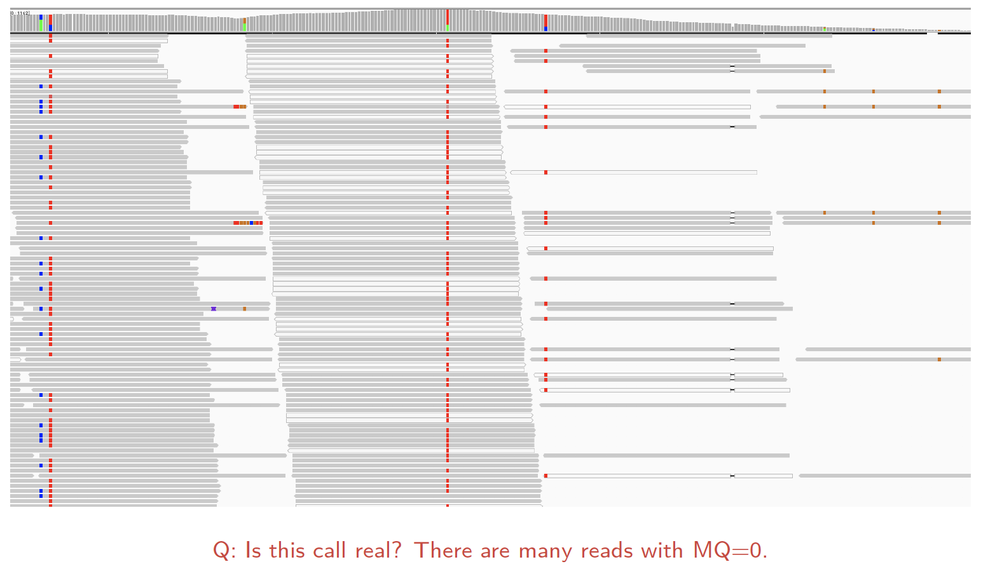
What do good SNPs look like?
Notes:
Looks suspicious – white reads have mapping quality 0 so they can be mapped equally well somewheere else

Slide 40
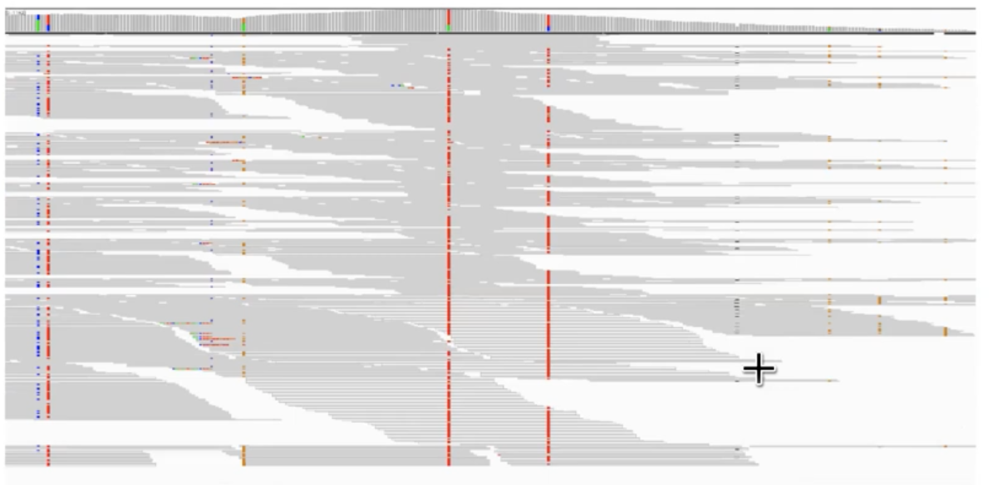
What do good SNPs look like?
Sorting the reads by MQ reveals the variant is also supported by many high-quality reads
Notes:
Sort by mapping quality, and by read direction, and the variant is present across all reads, so you can probably conclude that this is a good call

Slide 41
How to estimate the quality of called SNPs?
Transitions vs transversions ratio, known as ts/tv
transitions are 2-3× more likely than transversions
purines
adenine
A
Transitions
G
guanine
Transversions
Transversions
C
Transitions
T
pyrimidines
cytosine
thymine
Notes:
You have done variant calling and filtering. So how do we estimate how good our calls. This metric can give you a good idea of that
Related to mutational processes. They are know and they have a specific signature. Very common to see methylated cytosine undergo deamination to become thymine

Slide 42
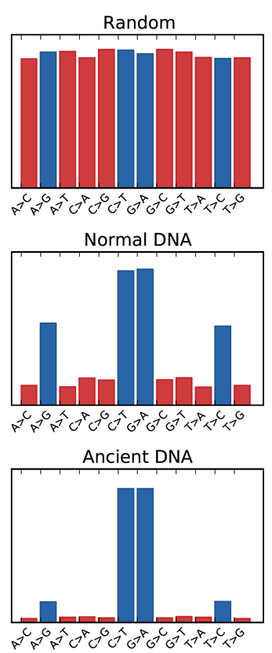
How to estimate the quality of called SNPs?
Transitions vs transversions ratio, known as ts/tv
transitions are 2-3× more likely than transversions
purines
adenine
A
Transitions
G
guanine
Transversions
Transversions
C
Transitions
T
pyrimidines
cytosine
thymine
Notes:
If you look at completely random mutations, generated by computer, you would get a pattern like this
In reality, what you see in your sequenicng, you see something like this, as they are much more frequent in nature
More extreme, in ancient DNA data- they have changes in a completely natural way – transitions are exacerbated
Measure this ratio, and you should get a fixed number – it is about 3 for exomes, about 2 for whole genomes

Slide 43
How to estimate the quality of called SNPs?
Transitions vs transversions ratio, known as ts/tv
transitions are 2-3× more likely than transversions
purines
adenine
A
Transitions
G
guanine
Transversions
Transversions
C
Transitions
T
pyrimidines
cytosine
thymine
Whole human genome ~ 2.1
Whole human exome ~ 2.8
Notes:
If you look at completely random mutations, generated by computer, you would get a pattern like this
In reality, what you see in your sequenicng, you see something like this, as they are much more frequent in nature
More extreme, in ancient DNA data- they have changes in a completely natural way – transitions are exacerbated
Measure this ratio, and you should get a fixed number – it is about 3 for exomes, about 2 for whole genomes

Slide 44
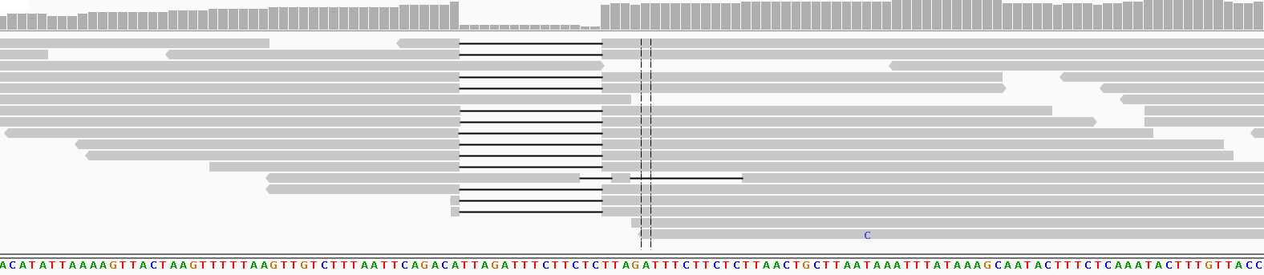
Indel calling challenges
The sequencing error rate is elevated in microsatellites
Low reproducibility across callers
37.1% agreement between HapCaller, SOAPindel and Scalpel
Narzisi et al. (2014) Nat Methods, 11(10):1033
Reads with indels are more difficult to map and align
the aligner can prefer multiple mismatches rather than a gap
indel representation can be ambiguous
CTTTAATTCAGACATTAGATTTCTTCTC
CTTTAATTCAGACATTAGATTTCTTCTCTTA
CTTTAATTCAGACA--------------TTAGATTTCTTCTCTTAACTGCTT CTTTAATTCAGACATTAGATTTCTTC---TA-----------TTAACTGCTT
CTTTAATTCAGACATTAGATTTCTTCTCTTAGATTTCTTCTCTTAACTGCTT
Notes:
IGV screenshot, the situation is explained at the bottom. Three haplotypes. Diploid sample so should not happen

Slide 45
Indel calling challenges
The sequencing error rate is elevated in microsatellites
Low reproducibility across callers
37.1% agreement between HapCaller, SOAPindel and Scalpel
Narzisi et al. (2014) Nat Methods, 11(10):1033
Reads with indels are more difficult to map and align
the aligner can prefer multiple mismatches rather than a gap
indel representation can be ambiguous
CTTTAATTCAGACA~~~~~~~~~~~~~~TTAGATTTCTTCTC
CTTTAATTCAGACA~~~~~~~~~~~~~~TTAGATTTCTTCTCTTA
CTTTAATTCAGACA--------------TTAGATTTCTTCTCTTAACTGCTT CTTTAATTCAGACA~~~~~~~~~~~~~~TTAGATTTCTTCTATTAACTGCTT
CTTTAATTCAGACATTAGATTTCTTCTCTTAGATTTCTTCTCTTAACTGCTT
Notes:
Realign. One haplotype, and one read has one sequencing error

Slide 46
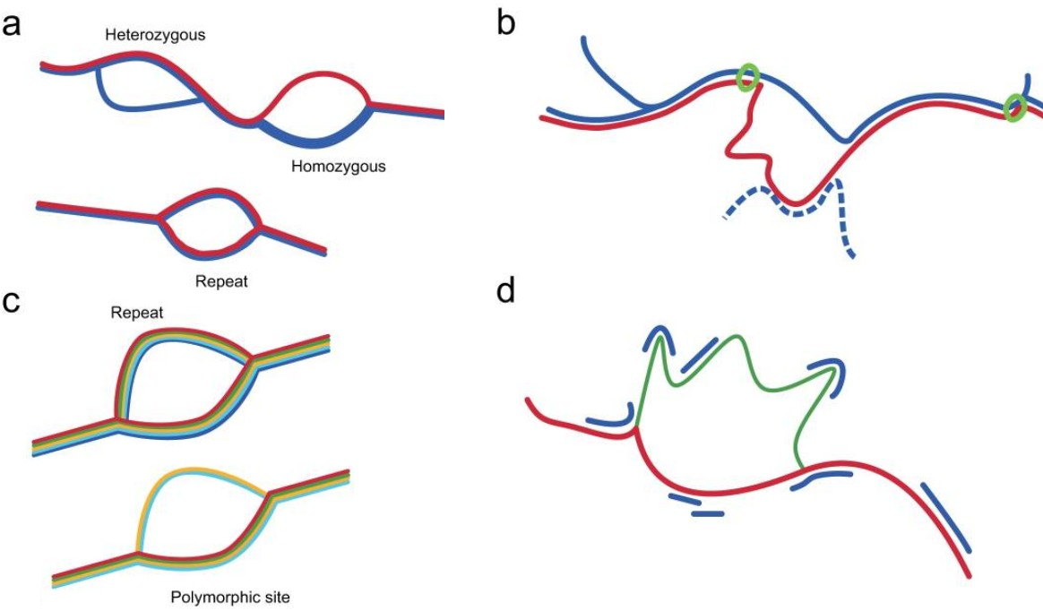
Future of variant calling
Current approaches
rely heavily on the supplied alignment, but aligners see one read at a time
largely site based, do not examine local haplotype and linked sites
Local de novo assembly based variant callers
call SNPs, indels, MNPs and small SV simultaneously
can remove alignment artefacts
eg GATK haplotype caller, Scalpel, Octopus
Variation graphs
align to a graph rather than a linear sequence
Iqbal et al (2012) Nat Genet 44(2):226
Notes:
Because indels are difficult – so be optimistic! We can do stuff with indels. Attempts to improve the situation.
We rely on alignments, but aligners only see one read at a time. Calling is also site-based, we don’t see the context, we don’t see the local haplotypes. There are various callers that try to fix this by looking at creating a local de novo assembly
Start using these variation graphs. The reference is a linear sequence but when there are big differences, SVs, these methodis not very accurate in breakpoints. But if you are aligning against a graph structure that contains all the possible variation there, we should be able to improve in aliinging and variant calling
Some implementations that are still in the testing phase, but it is promising

Slide 47
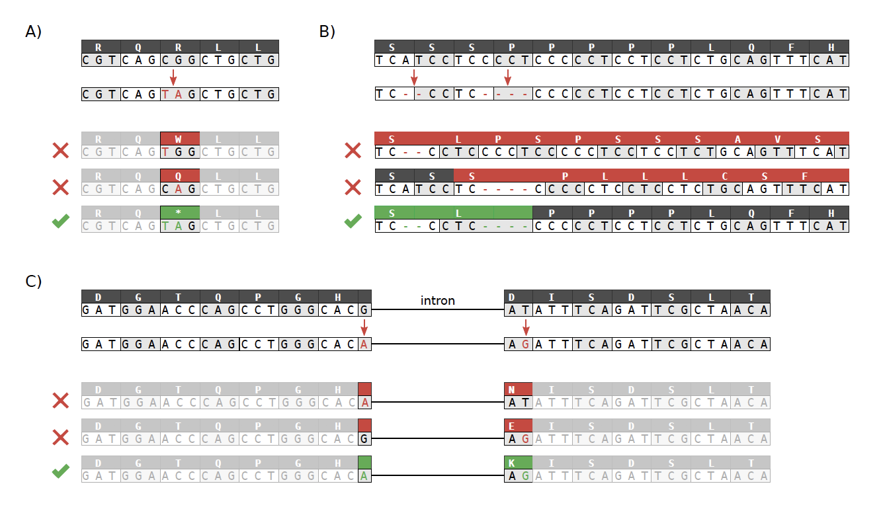
Functional annotation
VCF can store arbitrary INFO tags (per site) and FORMAT tags (per sample)
Describe genomic context of the variant (e.g. coding, intronic, UTR)
Predict functional consequence (e.g. synonymous, missense, start lost)
Several tools for annotating a VCF, only few are haplotype-aware
BCFtools/csq http://github.com/samtools/bcftools
VEP Haplosaurus http://github.com/willmclaren/ensembl-vep

Slide 48
Excercise time!
Open your VM
Open a terminal window.
Go to course_data/variant_calling
cd course_data/variant_calling/
Open the exercises, which are in Github or in:
/home/manager/course_data/variant_calling/practical/ \
variant_calling.pdf
Follow the instructions!

